Slide 1


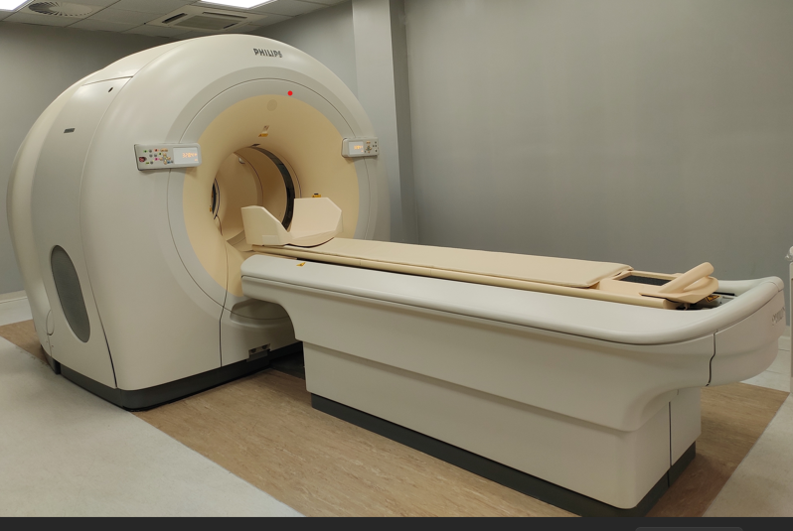
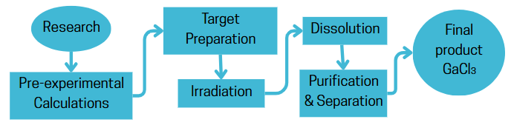
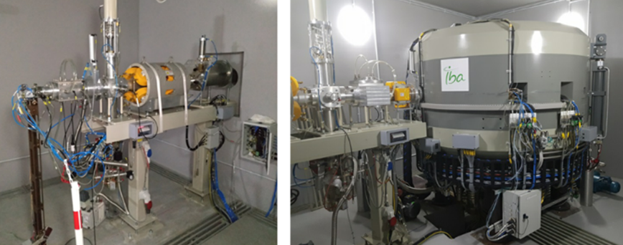
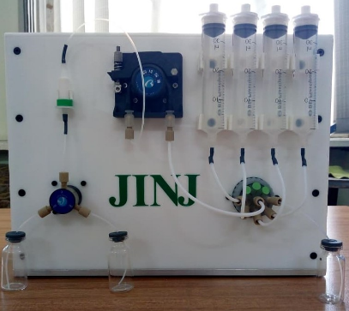
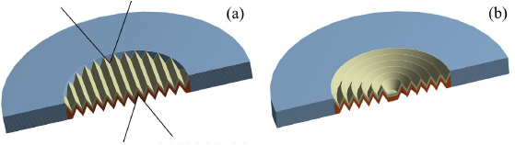
GALLIUM-68 MEDICAL ISOTOPE PRODUCTION USING C18 CYCLOTRON PROTON BEAM
Armine Grigoryan
PET CT
The IBA C18 cyclotron & beamline for experimental research
The proton-induced reactions in natural Zn & in enriched ⁶⁸Zn
(a) DLT (Double Linear Target), (b) DAT (Double Axial Target), (c) A zinc powder target pressed into a niobium target holder
KATIL Dissolution Station & JINJ Purification Station

Slide 2




Thank You!
Organizers and sponsors
AANL (YerPhI), IRP Department
Armine Grigoryan
Email: arminegrig@yephi.am
“Progress Throught Effective Science”
AAG-2026 Conference, Dilijan
May 11-16, 2026

